Slide 1


Supply Chain Analysis! For AtliQ Mart
Presented by : Swapnil Alaspure

Slide 2

Objective
AtliQ Mart, an FMCG manufacturer in Gujarat, faces customer contract issues due to service problems. Key customers have not renewed contracts, possibly due to delays or incomplete deliveries.
To address this, the company needs to track daily 'On-Time' (OT %), 'In-Full' (IF %), and 'On-Time In-Full' (OTIF %) delivery metrics to resolve issues before expanding to new cities.

Slide 3
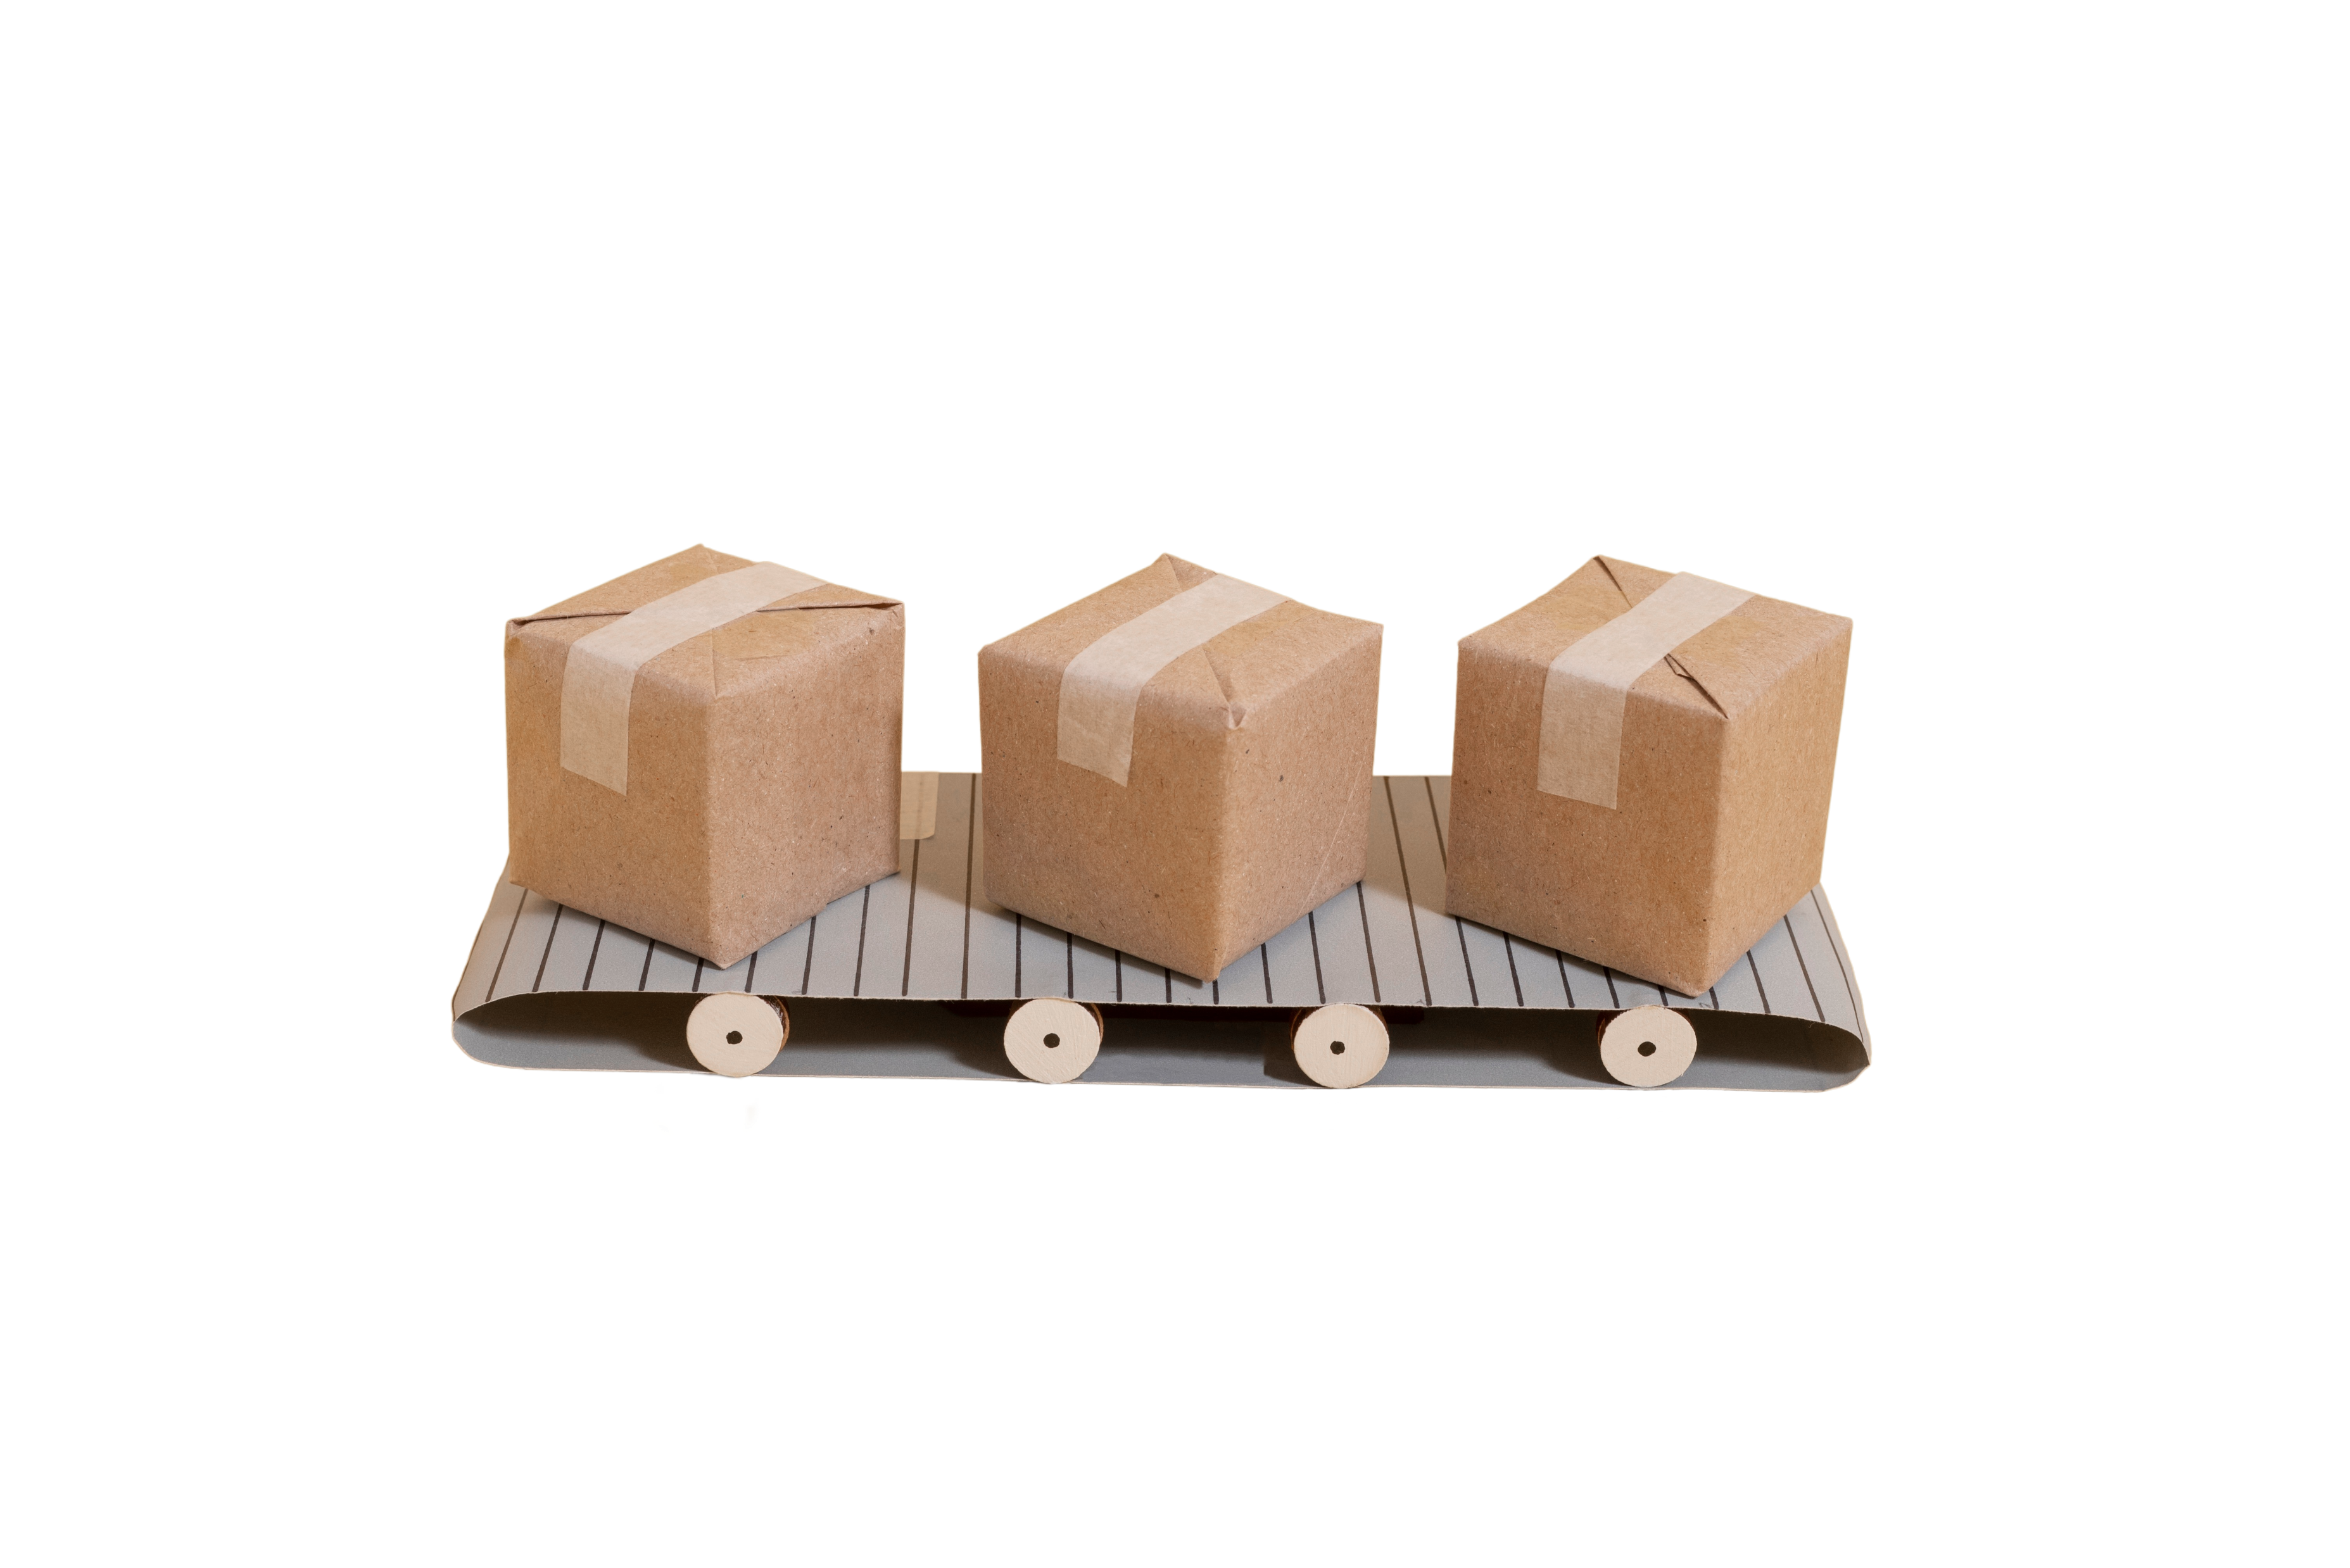
The key areas of focus were:
On-Time Delivery (OT%):
Measurement of the percentage of orders delivered on or before the promised delivery date.
In-Full Delivery (IF%):
Assessment of the percentage of orders delivered with the full quantity requested by customers.
On-Time In-Full Delivery (OTIF%):
Calculation of the combined metric (OTIF%) to track how often orders are delivered both on time and in full.
Line Fill Rate (LiFR%):
Line Fill Rate is an important metric for the supply planning team to understand how many lines they shipped out of the total lines ordered.
Volume Fill Rate (VoFR%):
Volume useful for the supply planning team to understand the total quantity they are able to ship for a customer per order or for a given period of time.
Daily Tracking and Response:
Implemented a dashboard to track daily OT, IF, and OTIF metrics, enabling the supply chain team to swiftly respond to service level issues.

Slide 4

Methodology
Data Collection:
The data for this analysis was sourced from Codebasics, covering the period from March to August.
This data provided a comprehensive overview of key supply chain metrics during this timeframe, allowing for a focused analysis on recent performance.
Tools and Techniques:
Utilized Power BI for the analysis, enabling the creation of detailed dashboards and visualizations to track and compare key performance indicators (KPIs) such as OT%, IF%, and OTIF%.
The analysis incorporated techniques like trend analysis and performance benchmarking to evaluate delivery service levels against the set targets.
Used Star Schema data model to do analysis.

Slide 5

Key Findings
All the Key Metrics (OT%, IF%, OTIF%) are far behind the target.
On an average, orders are delayed by 1.69 days from the estimated time of arrival.
Lotus Mart, Vijay Stores, Acclaimed stores, Rel Fresh have the highest orders as well as delayed the most to deliver the products on time.
Biscuits, Ghee, curd and butter products are most delayed to deliver.
There is no noticeable improvements in any of the key metrics in the last 5 months.
There is a huge gap in IF% and OTIF% for most of the customers.
Overall Line Fill Rate is 65.96% and Volume Fill Rate is 96.59%.

Slide 6

Presented by : Swapnil Alaspure

